Slide 1
4DSTEM Data Analysis
Nathanael Kazmierczak
08/15/2019

Slide 2
Contents
Standard strain mapping analysis (6.7º twist angle)
Non-standard analysis (1.2º twist angle)
Simulating overlap/resolution of Bragg disks, effects of strain

Slide 3
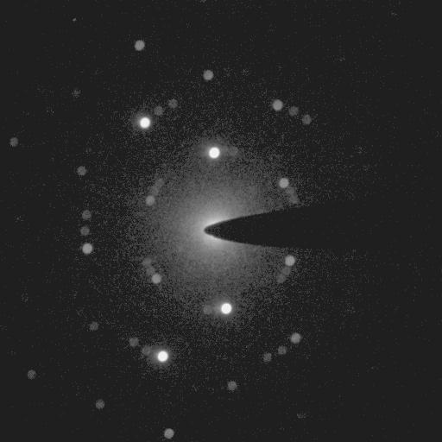
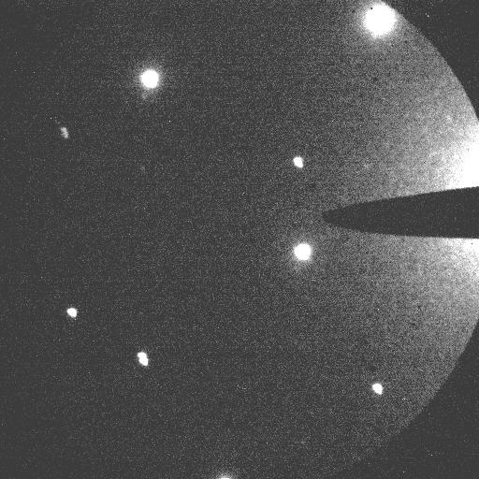
Data Examples (Two Sessions)
6.7º twist angle
1.2º twist angle

Slide 4
1: Overview of Standard Analysis
Define the disks which belong to graphene
Detect the center of the Bragg disks (“center of mass”)
Synthetic kernels given that the vacuum probe seems so much larger
Sort the Bragg disks into two sets for each graphene layer
Index each disk according to Miller indices
Compute the primitive lattice vectors and beam center which best match the Bragg disk locations.
Define “unstrained” lattice as median of all primitive lattice vectors
Compute strain through deviations from this lattice

Slide 5
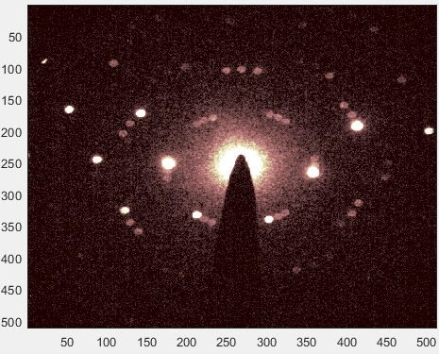
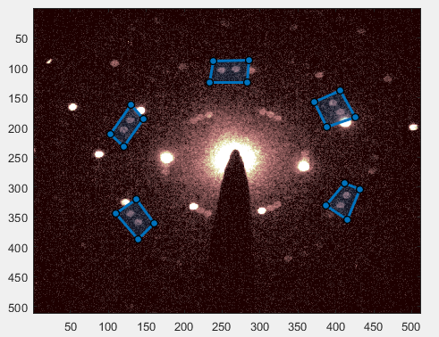
Overview of Standard Analysis
Draw Polygons

Slide 6
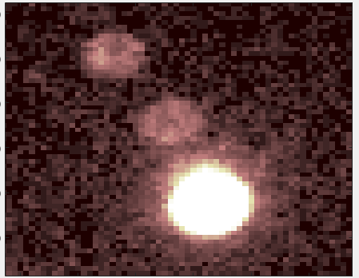
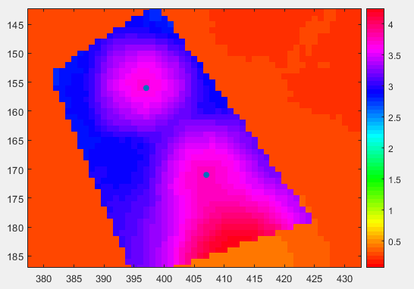
Convolutions
Four ways of thinking about what a convolution is doing:
Sliding a shape across an image.
Moving overlap integral
2-dimensional moving average
Vector inner product
Fourier transforms allow this to be calculated quite quickly.
Bragg peak locations are the local maxima of the convolution map.

Slide 7
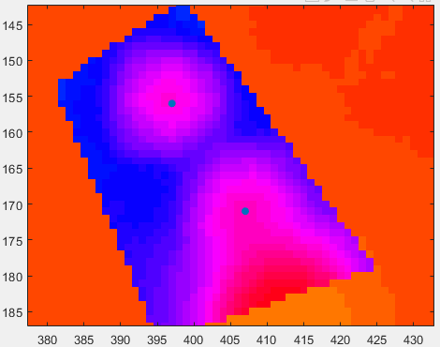
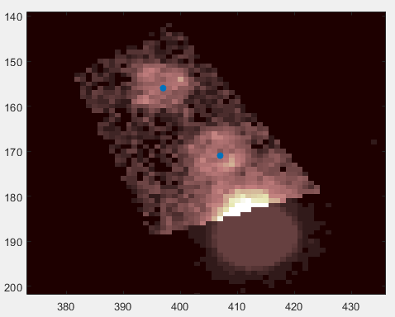
Overlay convolution peaks onto image

Slide 8
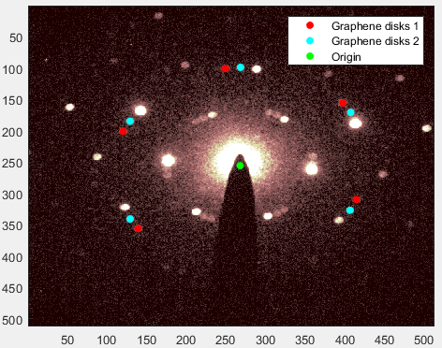
Sort Graphene Layers
“Origin” found from center of mass of all disk positions except the topmost two.
Peaks sorted by polar coordinates angle from the origin

Slide 9
Indexing of Bragg Disks
User draws to lattice vectors which provide a good initial guess as to the lattice
Bragg disks are subsequently indexed by the computer
(-1,1)
(-1,1)
(0,1)
(-1,0)
(0,1)
(-1,0)
u2 guess
u1 guess
(1,0)
(0,-1)
(1,0)
(0,-1)

Slide 10

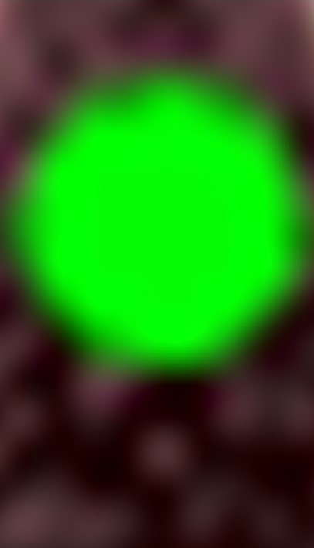
Calculation of Lattice Vectors
Computer now has five disks to fit for each graphene
Refines the lattice vectors and origin for the best possible fit
(-1,1)
(-1,1)
(0,1)
(-1,0)
(0,1)
(-1,0)
u2 guess
u2 calc
u1 calc
u1 guess
(1,0)
(0,-1)
(1,0)
(0,-1)

Slide 11
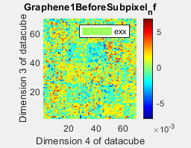
Strain Map
4 different parameters for each lattice, 8 plots total.
ε_{xx}: stretching along x-axis
ε_{yy}: stretching along y-axis
ε_{xy}: inter-axis shearing
θ: shearing angle
Notes:
The definitions of the different strain tensor elements constitute how I think about them, but there might be more precise language.

Slide 12
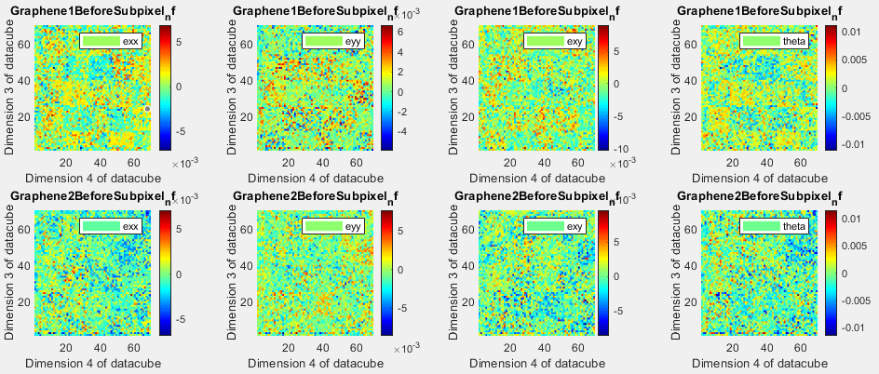
Unfiltered 6.7º Twist Angle, No Subpixel Detection
Notes:
Unfiltered here referring to only plotting things on a certain interval on the z-axis.

Slide 13
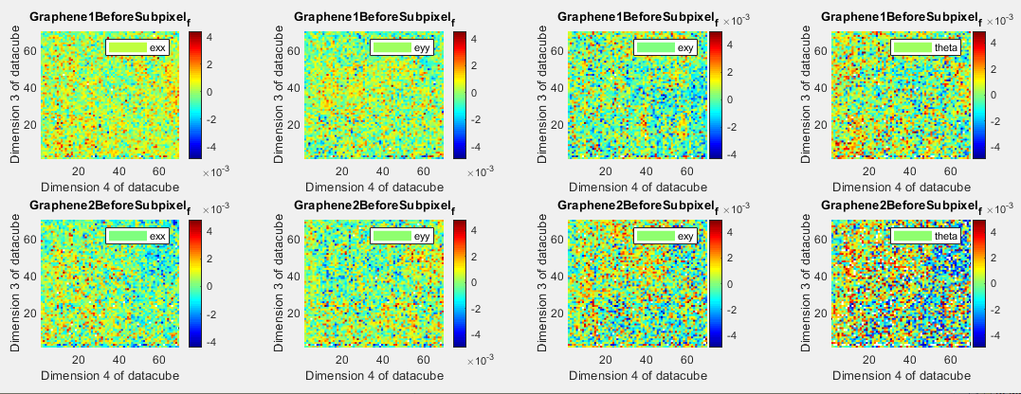
Filtered 6.7º Twist Angle, Parabolic Subpixel Detection
Square-like structure seems to go away with better algorithm.
Notes:
Unfiltered here referring to only plotting things on a certain interval on the z-axis. Filtered means that I have constrained the colormap axis to be between -0.005 and 0.005. The reason that the theta map is a lot more choppy is because it tends to have a larger variance than the other elements of the strain tensor, and some of them get cut off when we restrict the range like this.

Slide 14
2: Overview of Zoomed-in Data Analysis
Synthetic triangular kernel for disk registration
Have only two good Bragg peaks, cannot fit three parameters (two primitive lattice vectors + origin) to two data points
Power law fit elastically scattered electrons for center of beam position
Lattice vectors become simple displacements of Bragg triangles from fixed center
Strain computed relative to average vectors again.

Slide 15
Power Law Fitting
Three ways of doing this:
“Regular” power law least-squares fit
Logarithmic power law least-squares fit
Poisson maximum likelihood power law fit
Poisson MLE should be the most accurate due to statistical considerations
Two validation methods:
Center of mass of the six hBN peaks in the inner ring
Center of mass of eight graphene peaks in the outer ring
Psuedo-Voigt peak profiles could be a better shape than a power law for the future

Slide 16
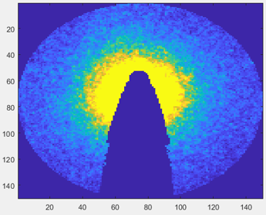
Masking
Draw polygon mask to cut out beamstop, avoid inner Bragg disk ring
Dark blue has been cut out
Same method as defining polygon regions for Bragg disk detection

Slide 17
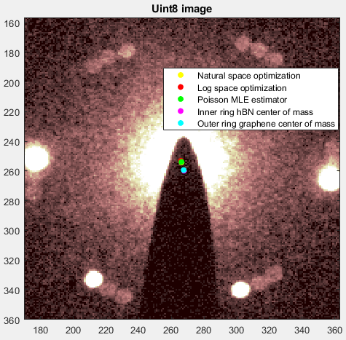
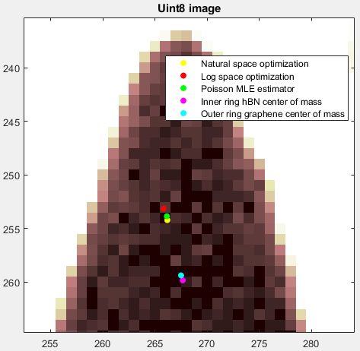
Center of Mass and Power Law Fits Do Not Agree
Each seems to be doing exactly what it was designed to do.

Slide 18
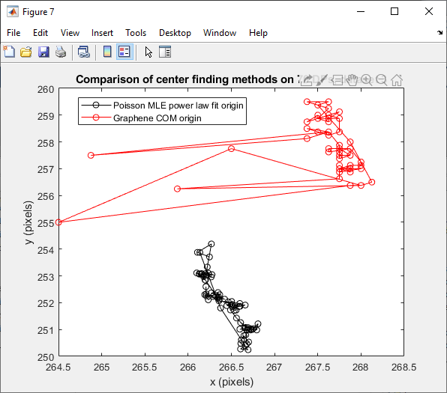
COM/Power Law Offset Seems Consistent
Wild red points occur when graphene disks were mis-detected
Problem has since been corrected
Disagreement is by 6 pixels in y, 1 pixel in x
70 diffraction patterns represented

Slide 19
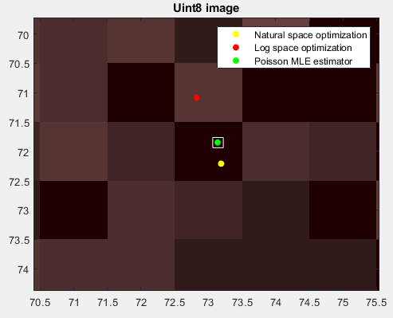
Poisson MLE Robust Against Noise
30 fold bootstrap of Poisson MLE coordinates conducted
Range of origin coordinates given by white box
Interpretation: the random noise in the data set does not hamper the power law fit
Beamstop distortions may still be an issue

Slide 20
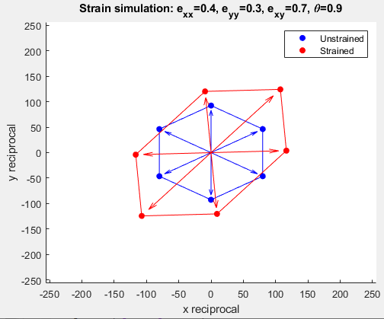
3: Simulations: Lattice defomation
Center of mass of a hexagon does not seem to change under arbitrary strain
Supports the disk center-of-mass approach for determining beam center

Slide 21
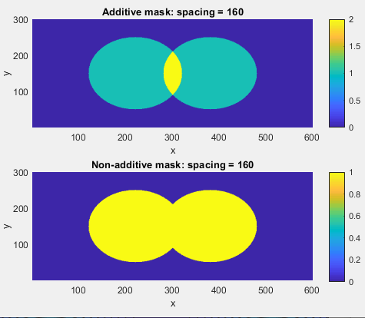
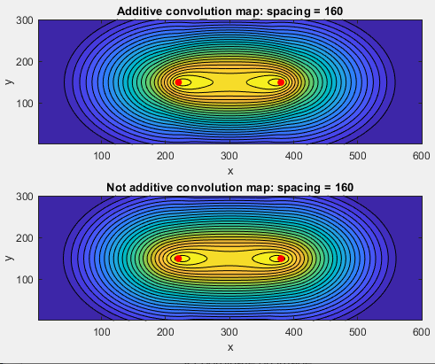
Convolution of Overlapping Disks
Notes:
No major changes in the convolution map as you change additive vs. non additive.

Slide 22
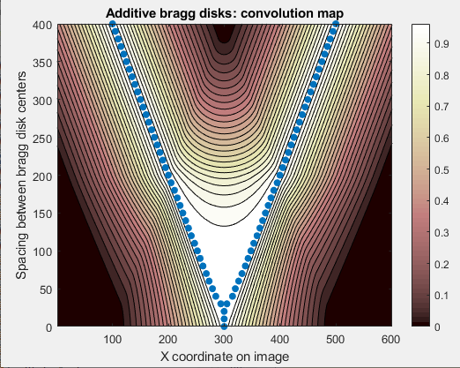

When Are Disks No Longer Resolved?
Disk radius is 100 pixels (see notes for graph description)
Notes:
These graphs are produced from around 40-50 of the graphs on the previous slide. For each, we take a horizontal slice across the convolution graph at the y-value where the centers of both disks are located.
That becomes a row vector representing the convolution map, which we then stack on top of each other as a function of the spacing between the disks. The blue dots indicate the maxima of those vectors. When we have two blue dots, this signifies that our two Bragg disks are successfully resolved. When we get only one dot, then they are not resolved. Mathematically I think it should be possible to resolve them for all spacings in the absence of error given the proper kernel radius, but the breakdown here around 30 pixel separation is indicative of the problem with pixelation around the edges of the disks.

Slide 23
(Near) Future Work
Disk registration for the overlapping triangles (1.2º twist angle)
Power law fitting for the beam center (1.2º twist angle)
Strain mapping (1.2º twist angle)
Github for code transfer
Look into transferring large data files online (Google Drive, Dropbox)
Decide on data binning
Timetables?

